Slide 1


Slide 2
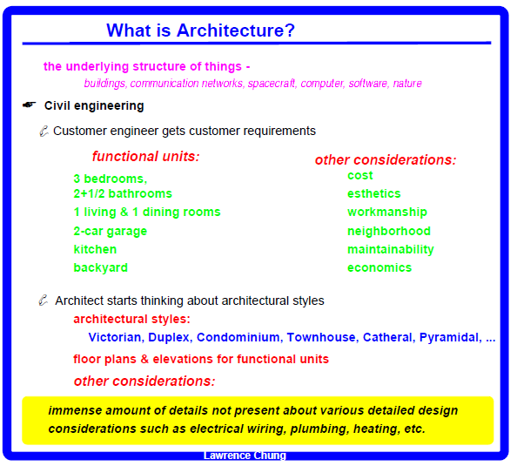

Slide 3
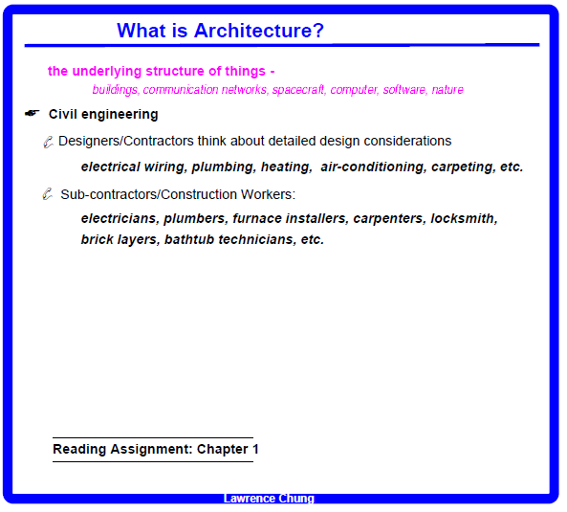

Slide 4
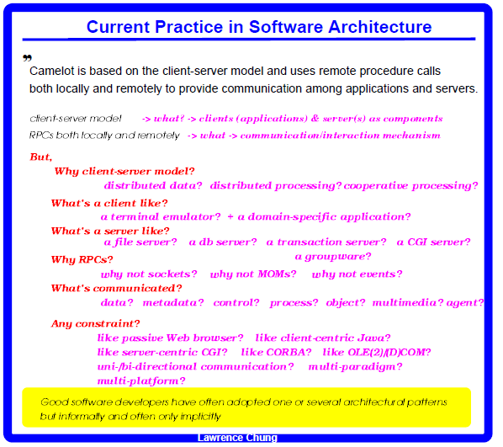







Slide 5
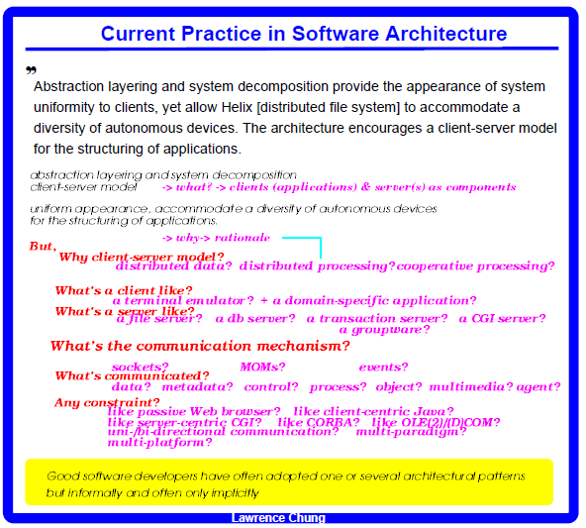

Slide 6
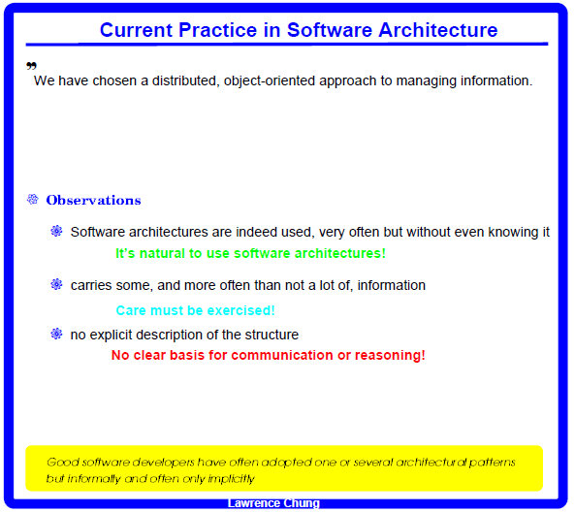























Slide 7


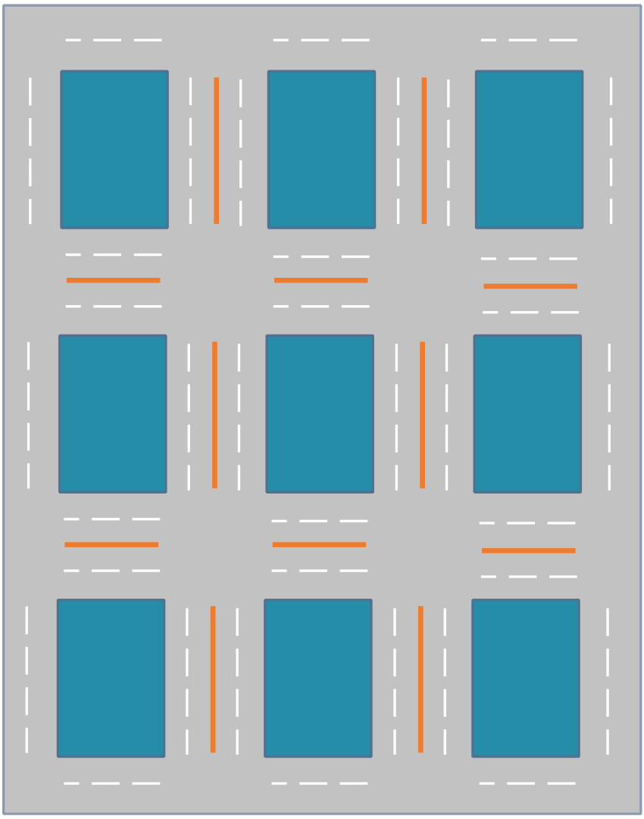


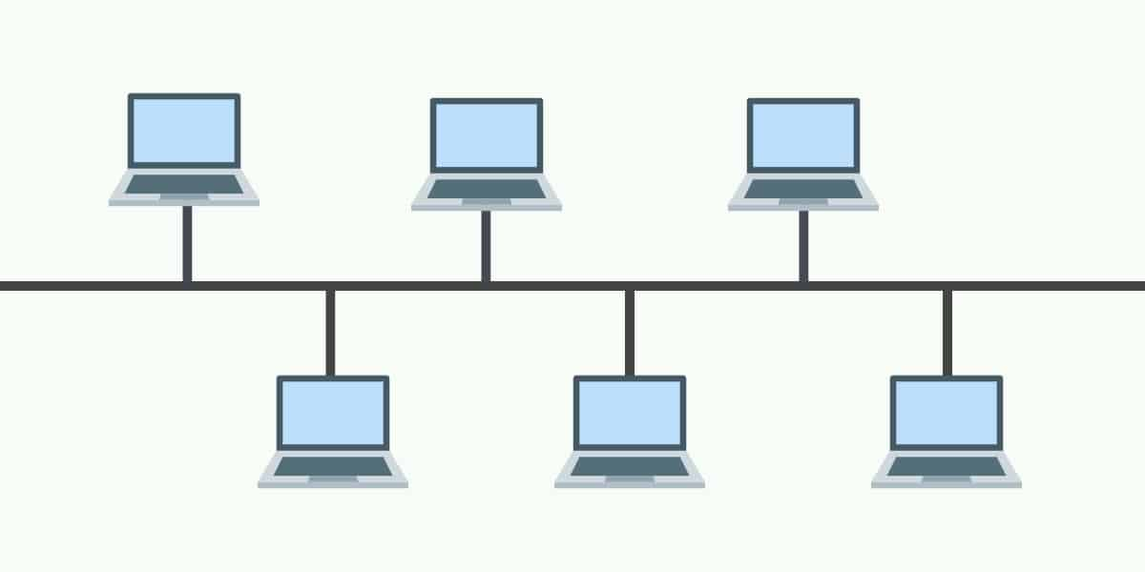
Patterns
Star
Gris/Manhattan
Ring
Bus
Tree
Mesh

Slide 8
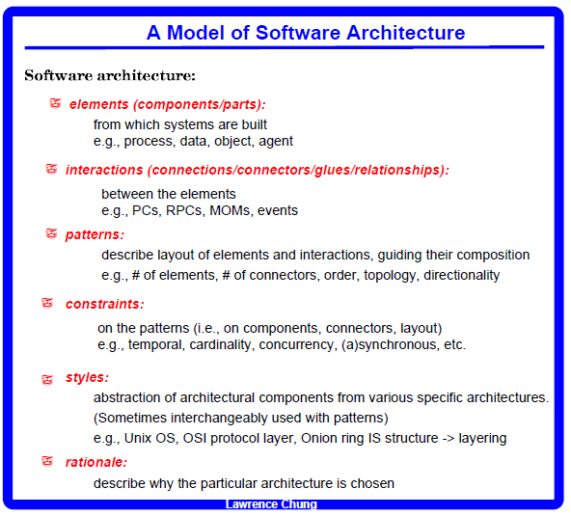

Slide 9
An Example of Software Architecture
A sequential compiler
Lexer
Parser
Semantic
Analyzer
Optimizer
Coder
Understand the difference between a software architecture and
a detailed design (data structure & algorithm)

Slide 10
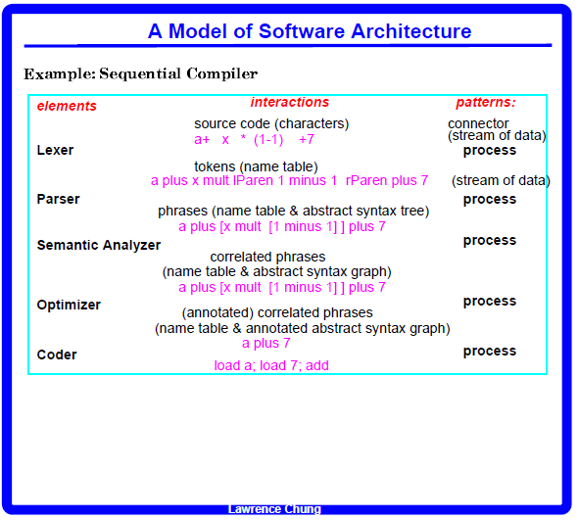








Slide 11
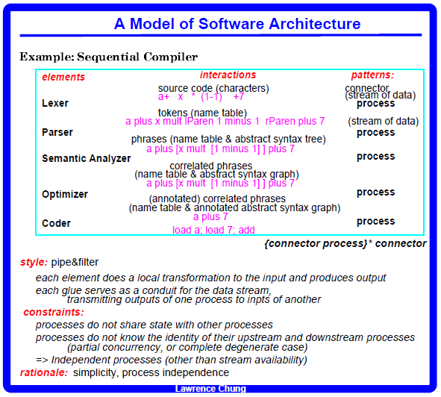

Slide 12
What’s a state
The current condition of the system and its data
Prog X
bool b1
bool b2
…
bool bn
S0 = {(b1,F), (b2,F), …, (bn,F)}

Slide 13
Unix OS
Lpr
Lpr | Sort
Lpr | pr
Lpr | sort | pr

Slide 14
Understand the difference between a software architecture and
a detailed design (data structure & algorithm)
Data Structure: A parse tree
e.g., 2 + (9 – 2) * 4 / (3 + 5)
+
2
*
-
Postorder
visit left
visit right
visit root
/
9
Load 2
Load 9
Load 2
Minus
Load 4
Load 3
Load 5
Plus
Div
Mult
plus
2
+
4
An algorithm (for the coder): Tree Traversal Algorithm
e.g., 2 + (9 – 2) * 4 / (3 + 5)
3
5

Slide 15
Pipe & Filter: appendum
Pipe & Filter in Unix
Show the use of multiple arch. Styles
Process architecture important, but there are other types of architectures too – What are they?

Slide 16
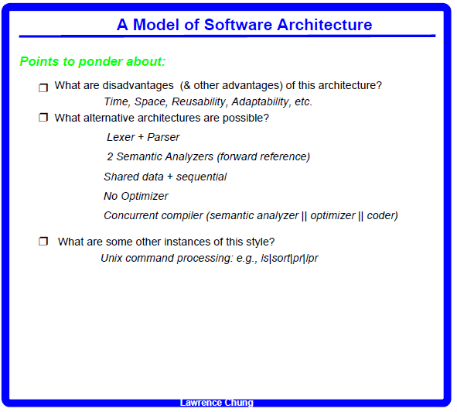
2-pass compiler ---- forward referencing
Class Emp
dept: Department
Class Department
emp: Employee

Slide 17
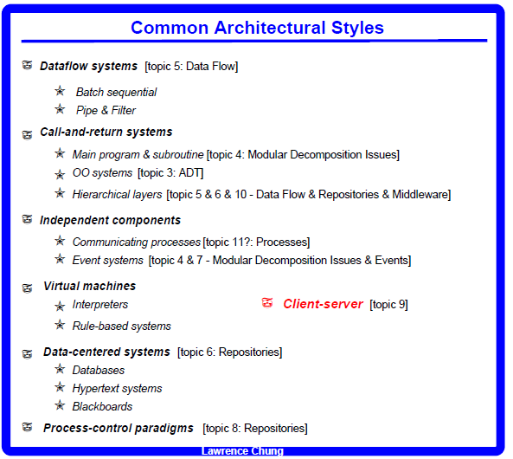

Slide 18
